Slide 1

Just-in-Time Adaptive Interventions
Alex Mariakakis
University of Toronto
Department of Computer Science

Slide 2
Why Make Interventions Adaptive?
Up until now, the methods and systems we have discussed have typically been one-size-fits-all
Interventions are always triggered in the same way
Models are globally trained
Algorithms have limited personalization
Everyone gets the same intervention
These methods and systems are easier to design and deploy, but they may work on certain people better than others

Slide 3
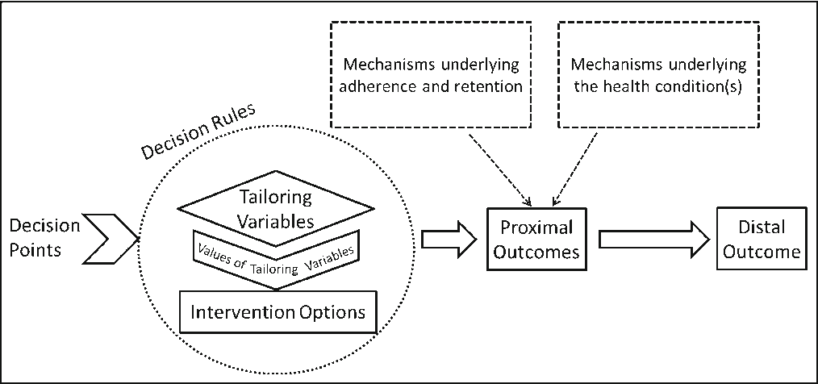
What Is A Just-in-Time Adaptive Intervention (JITAI)?
A JITAI is an intervention design aiming to provide the right type / amount of support, at the right time, by adapting to an individual's changing internal and contextual state
Mobile phone sensors can be used to identify the right moments for delivering interventions
Algorithms can be used to identify which interventions should be given

Slide 4
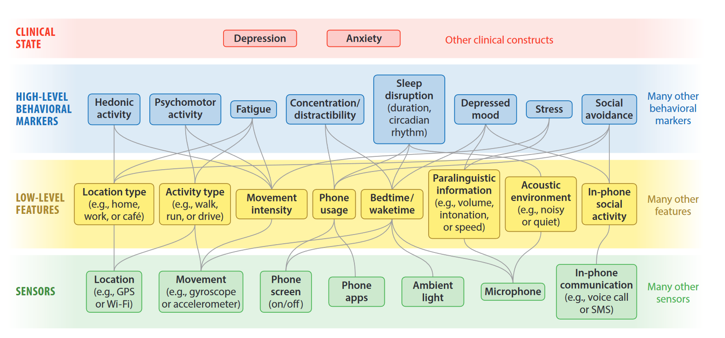
Examples of Tailoring Variables

Slide 5
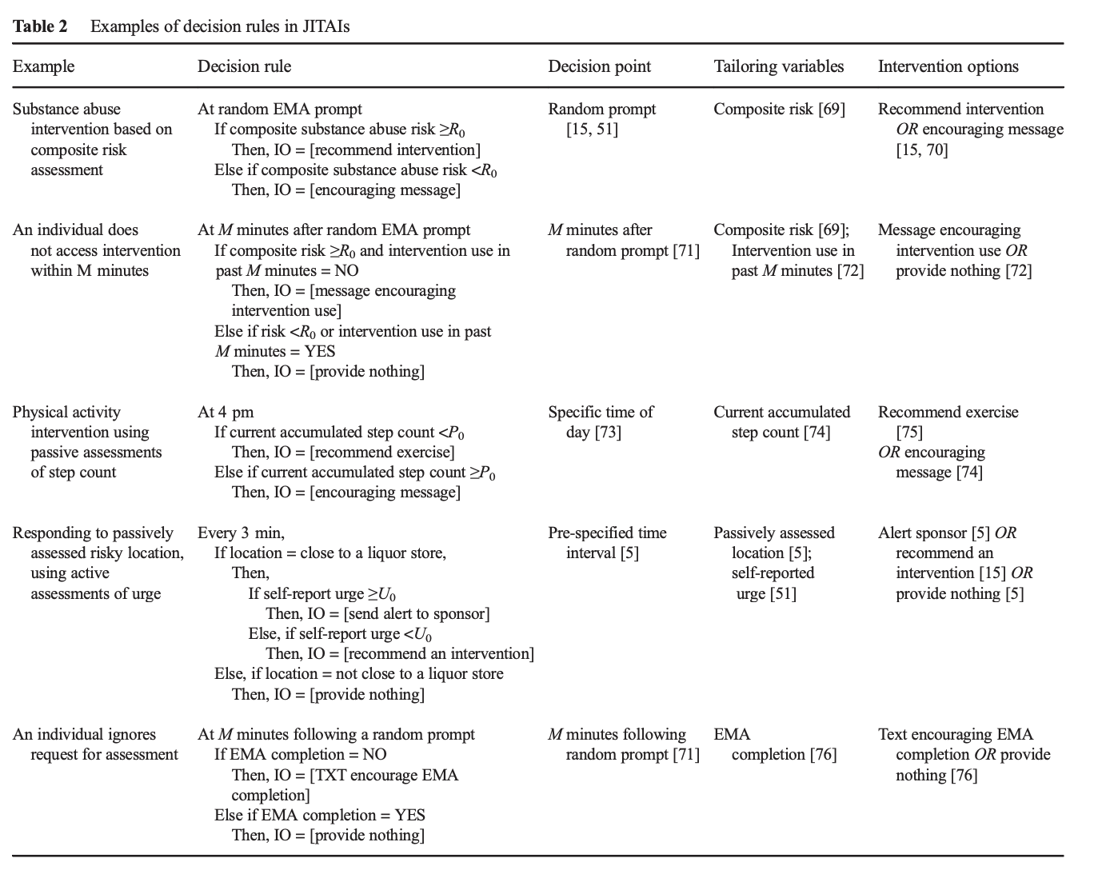
Examples of Outcomes and Interventions

Slide 6
Examples of Outcomes and Interventions

Slide 7
Resources
Just-in-Time Adaptive Interventions (JITAIs) in Mobile Health: Key Components and Design Principles for Ongoing Health Behavior Support (Nahum-Shani et al. ’16)

